Slide 1


^{Social Partnership} ^{in the Republic of Macedonia}
^{Zeqir Zeqiri, VET Center} ^{Director}
^{Vera Kondikj Mitkovska,} ^{Senior Project Manager}
June 4, 2012, Milocer, Montenegro

Slide 2
The role of the VET Center
Modern and high quality VET cannot be delivered by any organization working in isolation
The overall responsibility of the VET Center is to align and integrate the interests in VET of a diverse group of stakeholders
The Center coordinates the cooperation with the international institutions and organizations in the field of vocational education and training
On of the most important requirements of the VET Center is to develop and practice the highest standards of collaboration and partnership
Social Partnership in Macedonia

Slide 3
Types of Partnership Working
Operational partnership – activities carried out in working groups that are largely task oriented (development of plans, programs, assessment tests etc.)
Strategic partnership – developing the strategic aspects of VET provision in Macedonia (VET Center and Association of the Local Self Government Units ensuring relevance of profiles to the economic developments needs of the municipalities)
Social partnership: collaboration between the representatives of the state, the employers and the workforce to achieve particular objective (occupational standards, tailored made programs which enable skills needs to be met)
Regional and international partnership: developing relationships with EU institutions and other similar institutions (cooperation with VET Centers in the region and wider)
Social Partnership in Macedonia

Slide 4
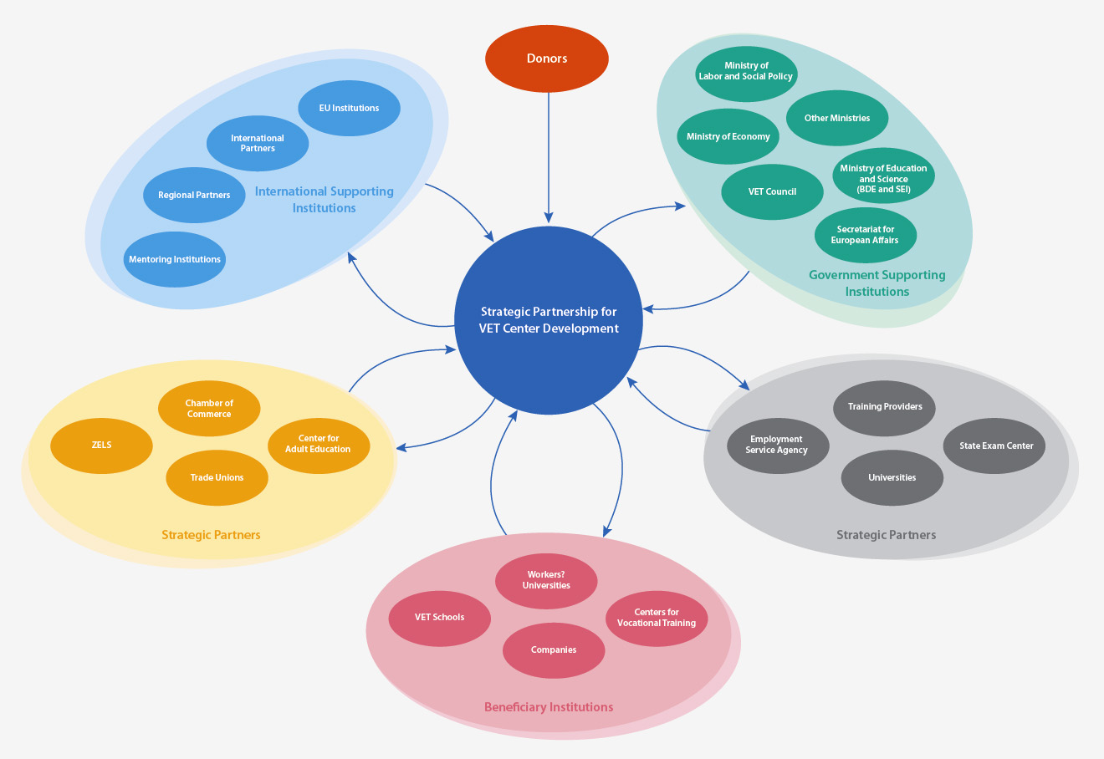
Model of Partnership Working of the VET Center
Professional partners
^{Развој на партнерско работење}

Slide 5
Social Partners in Macedonia
Who are the social partners:
Social partners are associations that represent the interest of the employees and employers which in cooperation with the Government and the local self government units implement the VET system in the country.
Law on VET, article 2
- employers’ associations on a national level – representatives of the employers and of business community (chambers of commerce and crafts, organization of workers, business confederation etc)
trade unions, representing the employees
ministries, representing the Government
the association of the local self government units
The above organizations are not social partners per se, but only become partners in particular context
Social Partnership in Macedonia

Slide 6
Legal Framework and Institutional Arrangements
Agreement for Social Partnership signed between the Government and the Federation of Trade Unions (2003)
Labour Law (2005)
National Program for Development of Education in RM, 2005-2015
Law on Vocational Education and Training (2006)
Social Partnership Protocol (2010)
Memorandum of Understanding and Cooperation (2010)
Partnership Framework (2010)
Strategy for Development of the VET Centre (2010-2015)
Social Partnership in Macedonia

Slide 7
^{Social Partnership} ^{Protocol}
Social Partnership Protocol singed in May 2010 between the VET Centre and the following organizations:
Ministry of Education and Science
Ministry of Labor and Social Policy
Employment Service Agency
VET Centre
Chamber of Commerce of Macedonia
Union of Chamber of Commerce of RM
Chamber of Crafts of Macedonia
Chamber of Commerce of South West Macedonia
Organization of employers
Business Confederation of Macedonia
Association of Local Self Government Units
Union for education, science and culture
Social Partnership in Macedonia

Slide 8
Responsibilities of the social partners:
Employers’ associations:
identify relevant employers to support activities related to development of VET
initiate consultative activities with employers and provide feedback to the VET Centre
promote the changes in the VET system to the business community and employers
Trade unions:
identify issues pertaining to working conditions, safety at work, remuneration, acquiring new working skills
initiate consultative activities with employees and forward feedback to the VET Centre on the quality of implementation of VET and on how useful curricula are
promote the benefits from the VET system with the intention of supporting employees’ career movement
Social Partnership in Macedonia

Slide 9
Responsibilities of the Government and LSGU:
Ministries
agree and allocate resources for supporting the work of the VET Centre
communicate to the VET Centre the data regarding the labour market and other relevant official statistic data
provide support to social partners in their capacity-building for the sake of more successful involvement in the Protocol
Local Self Government Units
provide support for the development of social partnership at the local level, including intensified cooperation among vocational schools, business firms and employees
forward information feedback to the VET Centre regarding the local labour market priorities
Social Partnership in Macedonia

Slide 10
Areas of Cooperation with Social Partners
Twinning project :
Support to the Modernisation of the Education and Training System
Development of Occupational standards (51)
Development of Vocational qualifications (25)
Revision of Curricula for 2 and 3 Year VET
Working groups with members from:
employers (2)
trade union (1)
VET schools (2)
Ministry of Education and Science (1)
VET Center advisor (1)
Social Partnership in Macedonia

Slide 11
Areas of Cooperation with the Social Partners
*
*
Electronic registry for accredited companies developed
*
Incentives for employers for realization of practical training (lobbing activities of the Social Partners )
Standard for realization of practical training in companies drafted
Realization of Practical Training in Companies
Increased interest and participation on behalf of the Chambers of Commerce and Crafts
Increased interest and support on behalf of the Ministry of Labor and Social policy
Difficult to attract representatives from the Trade Unions
Social Partnership in Macedonia

Slide 12
Obstacles/ challenges on Social partnership on an operational level
VET Center institutional capacities
- understaffing
- insufficient budget
- no data and knowledge management system
Lack of cooperation among the different Chambers of Commerce
Lack of incentives for realization of practical training in companies
Social Partnership in Macedonia

Slide 13
Obstacles/ challenges on Social partnership on a strategic level
Insufficient understanding of importance of VET at a national level
Absence of a strategic approach to VET at national level
Low levels of employer engagement
No interest on behalf of Trade Unions
Social Partnership in Macedonia

